Slide 1
Update in the Perioperative and Emergency Management of Novel Oral Anticoagulants
Annelise Gallien, MD FRCPC
Moncton City Hospital
Director Thrombosis & Anticoagulation Program

Slide 2
Presenter Disclosures
FACULTY/PRESENTER | ANNELISE GALLIEN
Grants/Research Support | Pfizer Bayer
Speaker’s Bureau/Honoraria | Servier Bayer Leo-Pharma Boehringer-Ingelheim
Consulting Fees | Boehringer-Ingelheim Bayer
Other

Slide 3
Objectives
Overview of the commercially available novel oral anticoagulants (NOACs)
- pharmacokinetics
- lab monitoring
Perioperative Management of anticoagulants
- warfarin vs NOACs
- elective vs urgent surgery
Management of bleeding
- review outcome data for major bleeding episodes
- bleeding protocol

Slide 4
Introduction
NOACs are changing how we manage patients with atrial fibrillation and venous thromboembolism
- Dabigatran (Pradaxa)
- Rivaroxaban (Xarelto)
- Apixaban (Eliquis)
Advantages over warfarin:
- rapid onset of action
- no monitoring required
- reduced risk of bleeding
Disadvantages:
- lack of monitoring ability
- lack of antidote (maybe)
- cost
Their increased use poses new challenges when bleeding complications occur
Perioperative management of the NOACs differs from warfarin

Slide 5
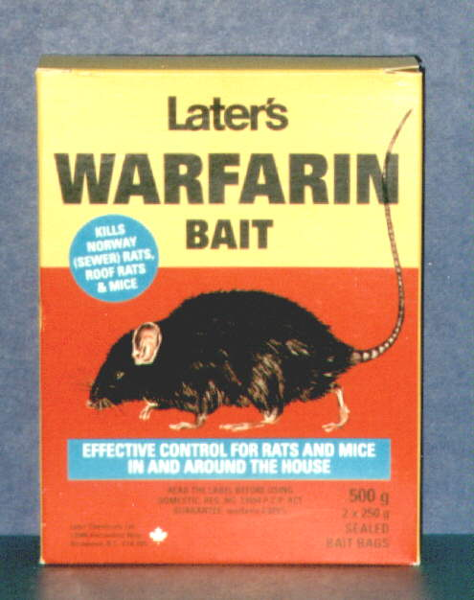
Is Warfarin becoming obsolete?
NO
Still preferred agent for:
- mechanical valves
- rheumatic mitral valve disease
- advanced renal failure
- high risk thrombophilias (APAS)
- cancer patients (if LMWH not used)
Cost/coverage

Slide 6
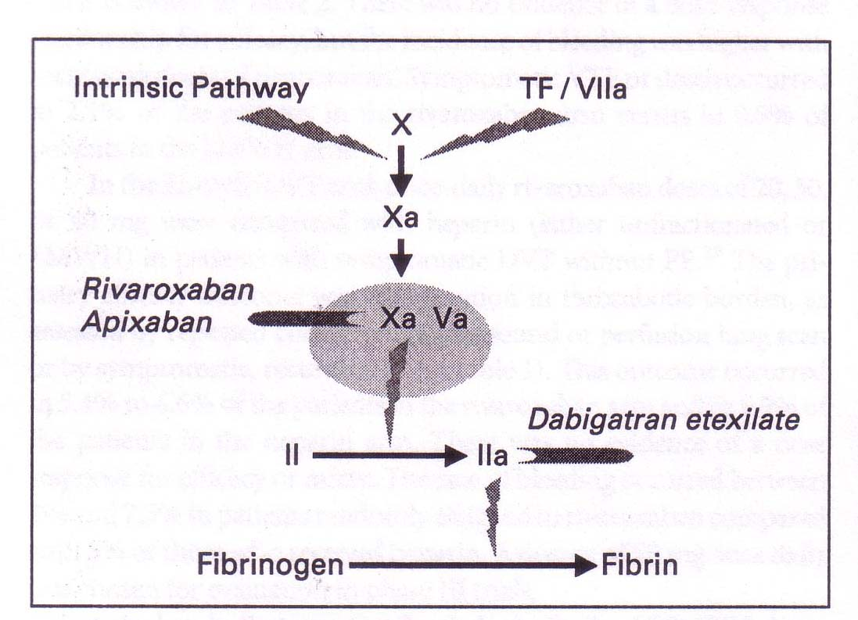
Action of new agents
Notes:
Dabigatran: oral thrombin inhibitor Rivaroxaban oral Xa inhibitor

Slide 7
Novel Oral Anticoagulants –
Pharmacological Properties
Characteristic | Rivaroxaban (Xarelto) | Dabigatran (Pradaxa) | Apixaban (Eliquis)
Target | Factor Xa | Factor IIa | Factor Xa
Prodrug | No | Yes | No
Dosing | OD | BID | BID
Bioavailability, % | 80-100%* | 6.5% | 50%
Half-life | 5-13h | 12-14 h | 8-15 h
Renal clearance (unchanged bioavailable drug) | ~33% | 85% | ~27%
Cmax | 2-4 h | 1-2 h | 3-4 h
Drug interactions | Strong inhibitors of both CYP3A4 and P-gp | P-gp inhibitors | Strong inhibitors of both CYP3A4 and P-gp
  1. Xarelto® PM, July 18, 2012 ; 2. Pradaxa ® PM November 12, 2012; 3. Eliquis® PM November 27, 2012; 4. Goette Trends Cardiovasc Med. 2013 [Epub ahead of print]
Notes:
Pradax ® Canadian product monograph January 27, 2012
Xarelto® Canadian Product Monograph, February 13, 2012
ELIQUIS® Canadian Product Monograph, 13 December 2011

Slide 8
Novel Oral Anticoagulants –
Effect on Coagulation Tests
 | Rivaroxaban ^{(Xarelto)} | Dabigatran ^{(Pradaxa)} | Apixaban ^{(Eliquis)}
aPTT | ↑ or ↔ | ↑ | ↑ or ↔
PT/INR | ↑ or ↔ | ↑ or ↔ | ↑ or ↔
Thrombin Time | Minimal effect | ↑ | Minimal effect
Hemoclot thombin inhibitor assay | No effect | ↑ | No effect
Anti Factor Xa | ↑ | Minimal effect | ↑
  1. Xarelto® PM, July 18, 2012 ; 2. Pradaxa ® PM November 12, 2012; 3. Eliquis® PM November 27, 2012; 4. Goette Trends Cardiovasc Med. 2013 [Epub ahead of print]
Notes:
Thrombin Time and Dabigatran: a prolonged TT indicates the presence of Dabigatran (too sensitive) but is not useful to determine intensity of anticoagulation
PT (not INR as it is standardized for warfarin) can be used in emergency situations for the factor Xa inhibitors but does not determine intensity of anticoagulation

Slide 9
Approved Indications
Drug | Apixaban | Dabigatran | Rivaroxaban
Approved Indication | Prophylaxis of DVT/PE in Orthopedic surgery Prevention of stroke in atrial fibrillation Treatment of DVT and PE | Prophylaxis of DVT/PE in Orthopedic surgery Prevention of stroke in atrial fibrillation Treatment of DVT and PE | Prophylaxis of DVT/PE in Orthopedic surgery Prevention of stroke in atrial fibrillation Treatment of DVT and PE

Slide 10

Perioperative Management of the NOACs

Slide 11
Goals of Perioperative Anticoagulation
Minimize window of “subtherapeutic” anticoagulation preoperatively
Normal hemostasis during surgery
Balance bleeding and thromboembolic risk post-operatively

Slide 12
Preoperative Management of Patients taking NOACs
Influenced by different factors:
- pharmacokinetics of the drug
- renal function
- elective vs urgent surgery
- bleeding risk of the procedure
Notes:
Renal function esp. Dabigatran

Slide 13
Bleeding Risks
Procedures not requiring discontinuation of anticoagulation:
- dental
- cataract surgery
- superficial surgeries (skin biopsy)
Procedures at low bleeding risk:
- prostate/bladder biopsies
- pacemaker implantation
Procedures at high bleeding risk:
- major surgery
- spinal/epidural anesthesia
- Lumbar puncture
- TURP
- kidney biopsy

Slide 14
NOAC (half life) | CrCl (ml/min) | LOW BLEEDING RISK | HIGH BLEEDING RISK
Dabigatran (Pradaxa) 14 (12-18) 18 (13-23) | >50 30-50 | ≥ 24 hrs (skip 2 doses) ≥ 48 hrs (skip 4 doses) | ≥ 48 hrs (skip 4 doses) ≥ 96 hrs (skip 8 doses)
Rivaroxaban (Xarelto) 8 (7-10) 11 (9-13) | >50 30-50 | ≥ 24 hrs (skip 1 dose) ≥ 24 hrs (skip 1 dose) | ≥ 48 hrs (skip 2 doses) ≥ 48 hrs (skip 2 doses)
Apixaban (Eliquis) 8 (7-10) 11 (9-13) | >50 25-50 | ≥ 24 hrs (skip 2 doses) ≥ 24 hrs (skip 2 doses) | ≥ 48 hrs (skip 4 doses) ≥ 48 hrs (skip 4 doses)
*CrCl calculated using Cockroft-Gault formula

Slide 15
Bridging Anticoagulation
In most circumstances bridging anticoagulation not required with NOACs
Need for bridging with Warfarin more complex
Notes:
Due to short time of interruption

Slide 16
Risk of Thromboembolism
 | Mechanical Heart Valve | Atrial Fibrillation | VTE
High Risk (>10%) | Any mitral valve prosthesis Older aortic valve prosthesis Recent stroke or TIA (within 6 months) | CHADS 5-6 Recent stroke or TIA (within 3 months) Rheumatic valve disease | Recent VTE (within 3 months) Severe thrombophilia
Moderate Risk (5-10%) | Bileaflet aortic valve prosthesis + ≥1 additional risk factor (CHADS) | CHADS 3-4 | VTE within 3-12 months Nonsevere thrombophilia
Low Risk (<5%) | Bileaflet aortic valve prosthesis with no additional risk factors or atrial fibrillation | CHADS 0-2 with no previous TIA or stroke | Single VTE >12 months and no other risk factors

Slide 17
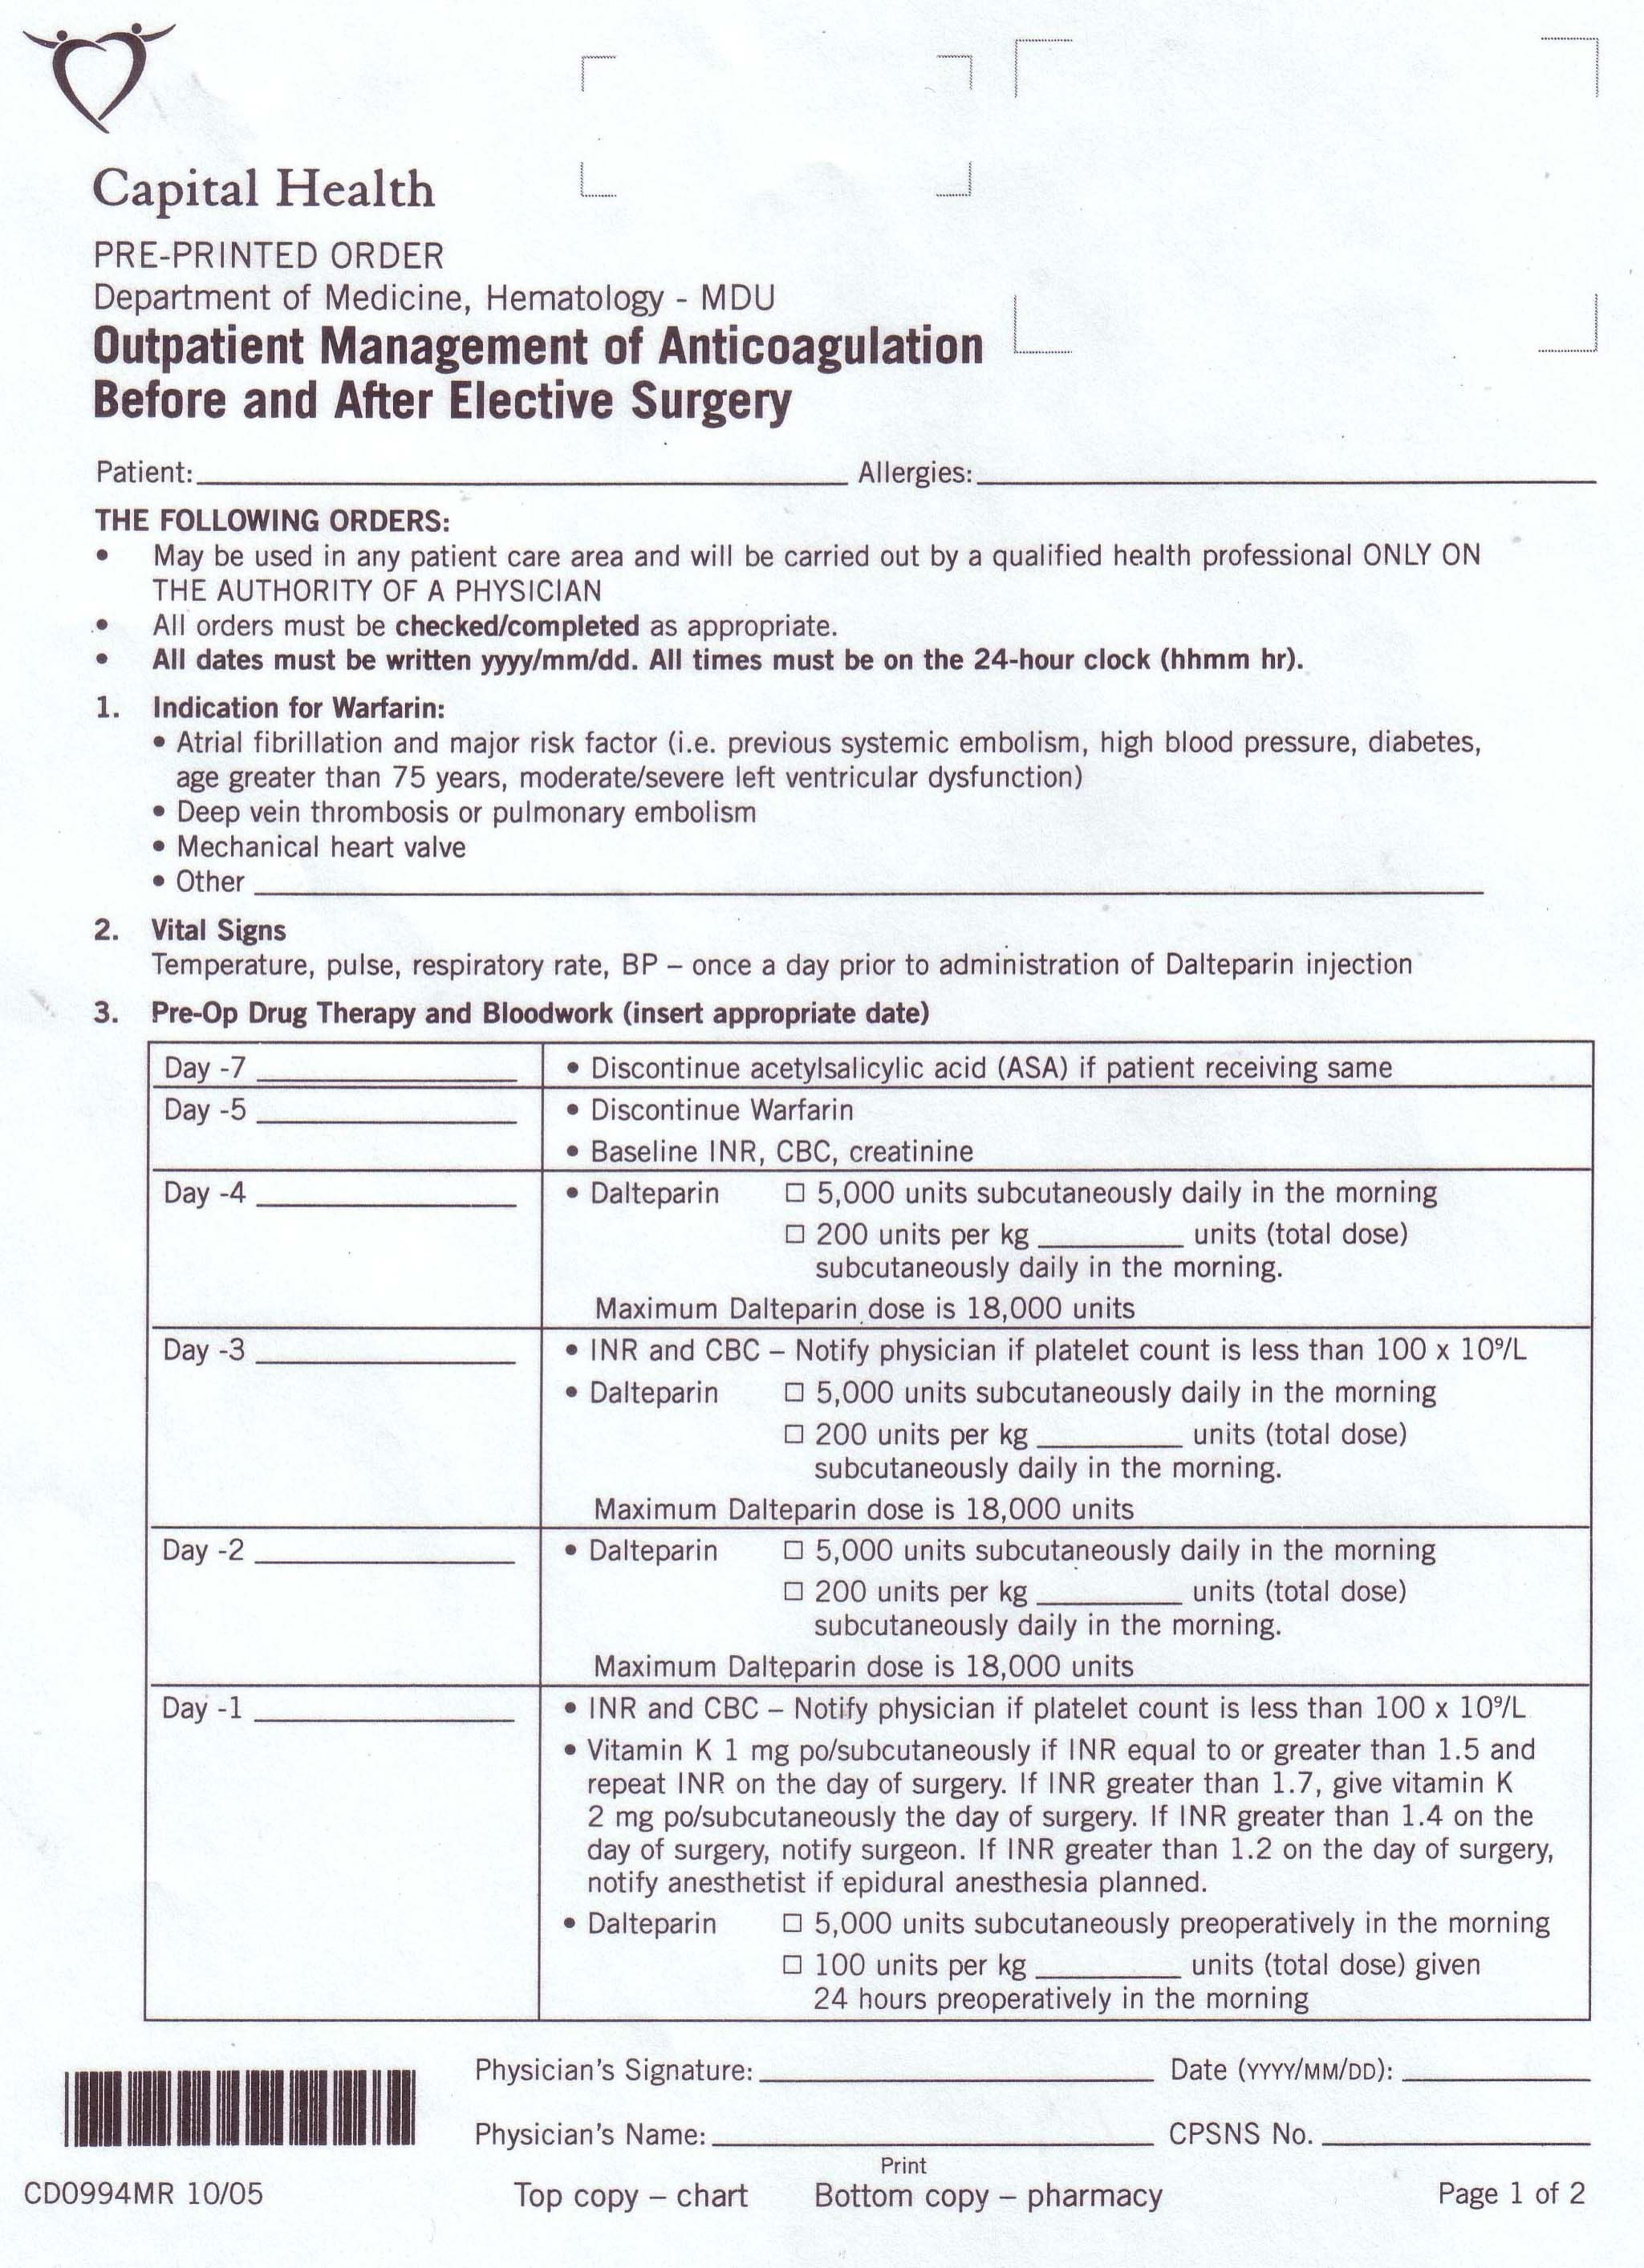
Warfarin

Slide 18
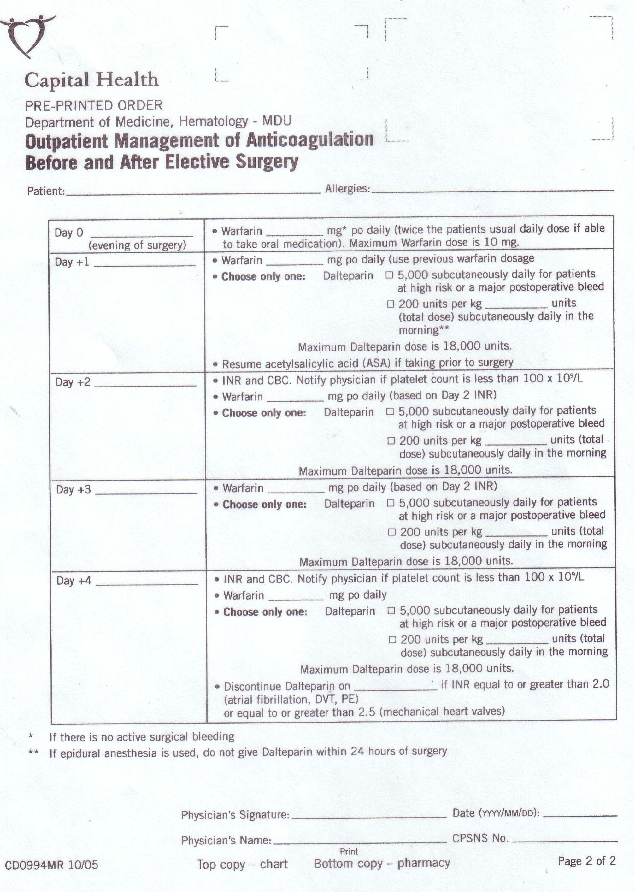
Warfarin

Slide 19
Coagulation Testing
Role of coagulation testing for elective procedures has not been determined and is not recommended
Managing patients that require emergency surgery is a challenge
- timing of last dose
- can test for non-specific tests of coagulation (PT, aPTT, thrombin time
- specific tests (Hemoclot, specific anti-Xa assays)
Need to weigh the benefits of emergency surgery against the risk of major hemorrhage.
Notes:
doesn’t tell you about intensity of anticoagulation
Coagulation testing dependent on lab capabilities

Slide 20
Post-procedure NOAC resumption
NOAC | LOW BLEEDING RIKS | HIGH BLEEDING RISK
Dabigatran (Pradaxa) | Resume AM post-op day +1 (24 hrs) | Resume AM post-op day +2 to +3 (48-72 hrs)
Rivaroxaban (Xarelto) | As above | As above
Apixaban (Eliquis) | As above | As above
Option to use low doses of NOACs or bridging with LMWH if felt full dose NOAC to be delayed
Notes:
Highlight difference with warfarin which can be restarted day of procedure

Slide 21
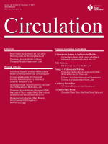
Periprocedural Bleeding and Thromboembolic Events with Dabigatran Compared with Warfarin: Results from RE-LY trial
Circulation. 2012;126:343-348

Slide 22
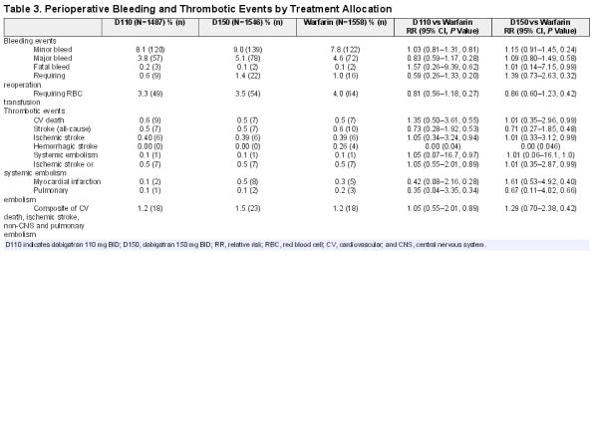

Table 3
© 2012 American Heart Association, Inc. Published by American Heart Association.
4
Notes:
There was no significant difference in perioperative major bleeding or in thromboembolic complications for elective surgery

Slide 23
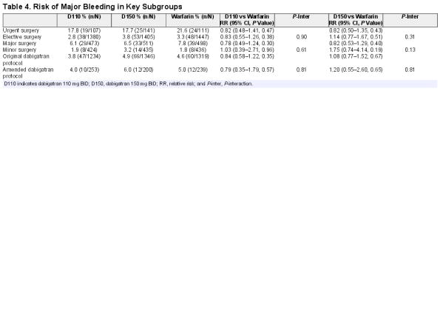
Table 4
© 2012 American Heart Association, Inc. Published by American Heart Association.
5
Notes:
No difference even if surgery was urgent

Slide 24
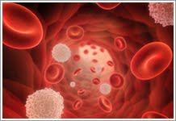
Bleeding Associated with NOACs

Slide 25
Management and Outcomes of Major Bleeding During Treatment with Dabigatran or Warfarin
Circulation. 2013;128:2325-2332
Notes:
Data on major bleeding events in 5 phase III trials

Slide 26
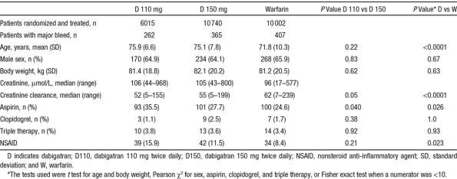
Table 2
© 2013 by the American College of Cardiology Foundation and the American Heart Association, Inc. . Published by American Heart Association.
3
Notes:
Patients who had a major bleeding event on Dabigatran were older, had worse renal function and were using more NSAIDS (higher risk patients)

Slide 27
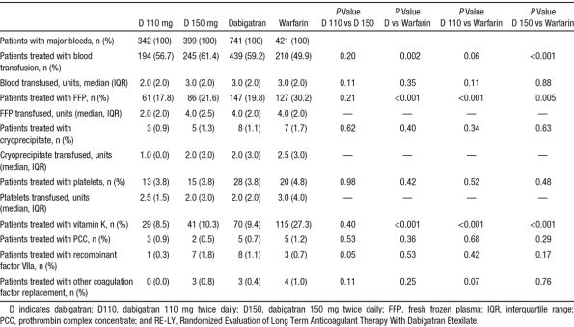
Table 3
© 2013 by the American College of Cardiology Foundation and the American Heart Association, Inc. . Published by American Heart Association.
4
Notes:
Patients in the dabigatran group received more blood transfusions (more GI bleeding, less intracranial bleeding), less FFP and Vitamin K
Highlight low FFP and Vitamin K use in warfarin group

Slide 28
Table 2
© 2013 by the American College of Cardiology Foundation and the American Heart Association, Inc. . Published by American Heart Association.
3
Notes:
Patients who had a major bleeding event on Dabigatran were older, had worse renal function and were using more NSAIDS (higher risk patients)

Slide 29
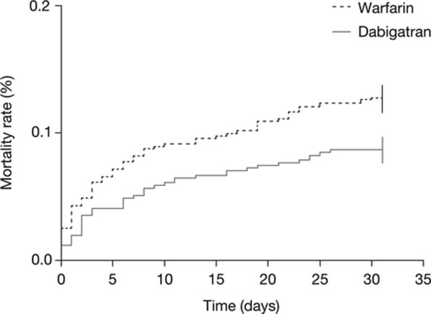
Figure.
© 2013 by the American College of Cardiology Foundation and the American Heart Association, Inc. . Published by American Heart Association.
6
Notes:
P=0.052

Slide 30

Management of major bleeding events in patients treated with Rivaroxaban vs. Warfarin: results from the ROCKET AF trial

Slide 31
Characteristic | Rivaroxaban (n = 431) | Warfarin (n = 409)
Number of major bleeds^{b}
1 | 361 (91.4%) | 359 (93.5%)
2 | 32 (8.1%) | 25 (6.5%)
>2 | 2 (0.5%) | 0 (0.0%)
Bleeding details
Bleeding associated with cardiac surgery (including CABG) | 0 (0.0%) | 2 (0.5%)
Bleeding associated with non-cardiac surgery | 19 (4.4%) | 27 (6.6%)
Epistaxis | 14 (3.2%) | 14 (3.4%)
GI: Upper (haematemesis or melena) | 164 (38.1%) | 105 (25.7%)
GI: Lower | 51 (11.8%) | 33 (8.1%)
Gingival | 1 (0.2%) | 2 (0.5%)
Haematoma | 13 (3.0%) | 26 (6.4%)
Haemoptysis | 5 (1.2%) | 4 (1.0%)
Increased or prolonged menstrual or abnormal vaginal bleeding | 3 (0.7%) | 1 (0.2%)
Intra-articular | 16 (3.7%) | 21 (5.1%)
Intracranial | 55 (12.8%) | 84 (20.5%)
Intramuscular (with compartment syndrome) | 2 (0.5%) | 1 (0.2%)
Intramuscular (without compartment syndrome) | 2 (0.5%) | 4 (1.0%)
Intraocular/retinal | 19 (4.4%) | 27 (6.6%)
Macroscopic (gross) haematuria | 27 (6.3%) | 21 (5.1%)
Pericardial | 0 (0.0%) | 1 (0.2%)
Puncture site | 2 (0.5%) | 4 (1.0%)
Rectal | 28 (6.5%) | 8 (2.0%)
Retroperitoneal | 1 (0.2%) | 3 (0.7%)
Skin (ecchymosis other than instrumented site) | 2 (0.5%) | 3 (0.7%)
Subconjunctival or other ocular | 0 (0.0%) | 1 (0.2%)
Other | 7 (1.6%) | 19 (4.6%)

Slide 32
Hospitalization and transfusion for major bleeding event by randomized treatment
Rivaroxaban (n = 431) | Warfarin (n = 409)
N = subjects, median (25%, 75%)
Duration of hospitalization within 5 days of major bleed | N = 101 5 (4–10) days | N = 91 6 (4–11) days
Transfusions within 5 days of major bleed
Packed red blood cells | N = 176 2 (2–4) units | N = 143 2 (2–4) units
Whole blood cells | N = 8 2 (1–3) units | N = 6 2 (2–4) units
Platelets | N = 4 3 (2–5) units | N = 6 5 (3–6) units
Fresh frozen plasma | N = 45 2 (1–2) units | N = 81 2 (2–4) units
Cryoprecipitate | N = 1 1 (1–1) units | N = 1 1 (1–1) units
Number of total units of packed red blood cells or whole blood cells transfused
≥2 | 159 (36.9%) | 129 (31.5%)
≥4 | 59 (13.7%) | 51 (12.5%)
Notes:
Rivaroxaban shorter duration of hospitalization, more patients received blood transfusions

Slide 33
Outcomes post-major bleed
Outcomeª | Rivaroxaban (n = 431) | Warfarin (n= 409) | HR (95% CI)^{b} | Treatment × major bleed interaction, P-value^{c}
Stroke or systemic embolism^{d} | 20 (4.7%) | 22 (5.4%)
Time to stroke or SE, median (range), days | 64 (16–249) | 15 (1–71)
Post-major bleed |  |  | 0.888 (0.420, 1.876) | 0.5135
Pre/no major bleed |  |  | 1.102 (0.715, 1698)
Composite of all stroke, non-CNS embolism, MI/UA, and all-cause death | 104 (24.8%) | 120 (29.9%)
Time to composite of all stroke, non-CNS embolism, MI/UA, and all-cause death, median (range), days | 58 (8–248) | 11 (2–82)
Post-major bleed |  |  | 0.758 (0.530, 1.082) | 0.0975
Pre/no major bleed |  |  | 0.970 (0.768, 1.225)
All-cause death | 86 (20.4%) | 105 (26.1%)
Time to all-cause death, median (range), days | 60 (8–246) | 7 (2–88)
Post-major bleed |  |  | 0.688 (0.455, 1.042) | 0.1098
Pre-/no major bleed |  |  | 0.905 (0.686, 1.194)
MI/UA | 11 (2.6%) | 7 (1.7%)
Time to MI/UA, median (range), days | 282 (9–485) | 14 (3–26)
Post-major bleed |  |  | 1.848 (0.572, 5.971) | 0.5597
Pre/no major bleed |  |  | 1.374 (0.707, 2.670)
Notes:
No difference in stroke, embolism, all cause death

Slide 34
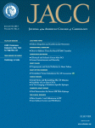
Major Bleeding in Patients With
Atrial Fibrillation Receiving Apixaban or Warfarin
The ARISTOTLE Trial (Apixaban for Reduction in Stroke and Other Thromboembolic Events in Atrial Fibrillation):
Predictors, Characteristics, and Clinical Outcomes

Slide 35
 | Overall(n = 18,140) | Apixaban(n = 9088) | Warfarin(n = 9052) | Apixaban vs. WarfarinHR (95% CI) | p Value*
Led to hospitalization | 1.23 (374) | 1.05 (162) | 1.41 (212) | 0.75 (0.61–0.92) | 0.0052
Fall in hemoglobin ≥2 g/dl | 1.25 (381) | 1.06 (164) | 1.44 (217) | 0.74 (0.60–0.91) | 0.0035
Led to transfusion | 1.06 (325) | 0.89 (137) | 1.25 (188) | 0.71 (0.57–0.89) | 0.0025
Required medical or surgical consultation | 1.74 (527) | 1.54 (236) | 1.94 (291) | 0.79 (0.67–0.94) | 0.0080
Required medical or surgical intervention to stop | 0.77 (236) | 0.65 (100) | 0.90 (136) | 0.72 (0.56–0.93) | 0.012
Associated with hemodynamic compromise | 0.32 (97) | 0.26 (40) | 0.38 (57) | 0.69 (0.46–1.029) | 0.069
Caused changed in antithrombotic therapy | 1.31 (398) | 1.14 (176) | 1.47 (222) | 0.78 (0.64–0.95) | 0.012
Notes:
Fewer hospitalizations, fewer medical/surgical interventions to stop bleeding, fewer transfusions

Slide 36
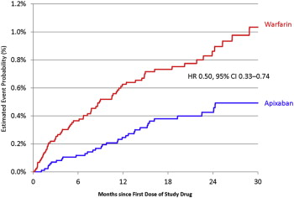
Major bleeding following death within 30 days
Notes:
50% reduction in 30 day mortality

Slide 37
Reversal of NOAC anticoagulant effect
Prothrombin Complex Concentrate (PCC)
- 3 factor PCC (factors II, IX, X)
- 4 factor PCC (factors II, VII, IX, X) Octaplex, Beriplex
No high-quality evidence efficacy and safety of PCC in the bleeding patient
PCC associated with 1.4% risk of thrombosis when administered to bleeding patients on warfarin
Notes:
Mostly animal models and healthy human non-bleeding volunteers

Slide 38
Reversal of NOAC anticoagulant effect
Activated Prothrombin Complex Concentrate (FEIBA)
- contains activated factors II, VII, IX, X
- developed for hemophiliacs with factor
inhibitors
- clinical data in bleeding patients is lacking (1 case report)
- in vitro data suggests it corrects some abnormal coagulation parameters for all 3 NOACs
- risk of thrombosis 4-8 events/100 000 infusions in
hemophilia
Notes:
Point 3: one case report of aPCC used in dabigatran treated paitent with iatrogenic hemopericardium

Slide 39
Reversal of NOAC anticoagulant effect
Recombinant factor VIIa
- also developed for hemophilia patients with inhibitors
- in animal models, rfVIIa failed to ameliorate bleeding following treatment with Dabigatran or Rivaroxaban
- variable effect on Rivaroxaban and Apixaban coagulation parameters in vitro
- twice the risk of thrombotic complications

Slide 40
Reversal of NOAC anticoagulant effect
Plasma (FFP):
- not shown to reverse abnormal coagulation tests
- risks include volume overload, TRALI, allergic reactions, infection

Slide 41
Adjunctive Therapies
Desmopressin (DDAVP):
- used for bleeding in context of platelet dysfunction (uremia, VWD)
- no clinical data
- watch serum Na
- in perioperative setting, no increased risk of thrombosis
Tranexamic Acid:
- antifibrinolytic
- can be used as adjunctive therapy for severe bleeding in a variety of circumstances
- effect in NOAC bleeding unknown
- no increased risk of thrombosis in perioperative setting
Notes:
Stabilizes fibrin clots in interfering with fibrinolysis

Slide 42
Hemodialysis
Dabigatran can be removed by hemodialysis
49%-68% removed after 4 hours of dialysis in patients with ESRD
Rivaroxaban and Apixaban are highly protein bound which limits removal with hemodialysis

Slide 43
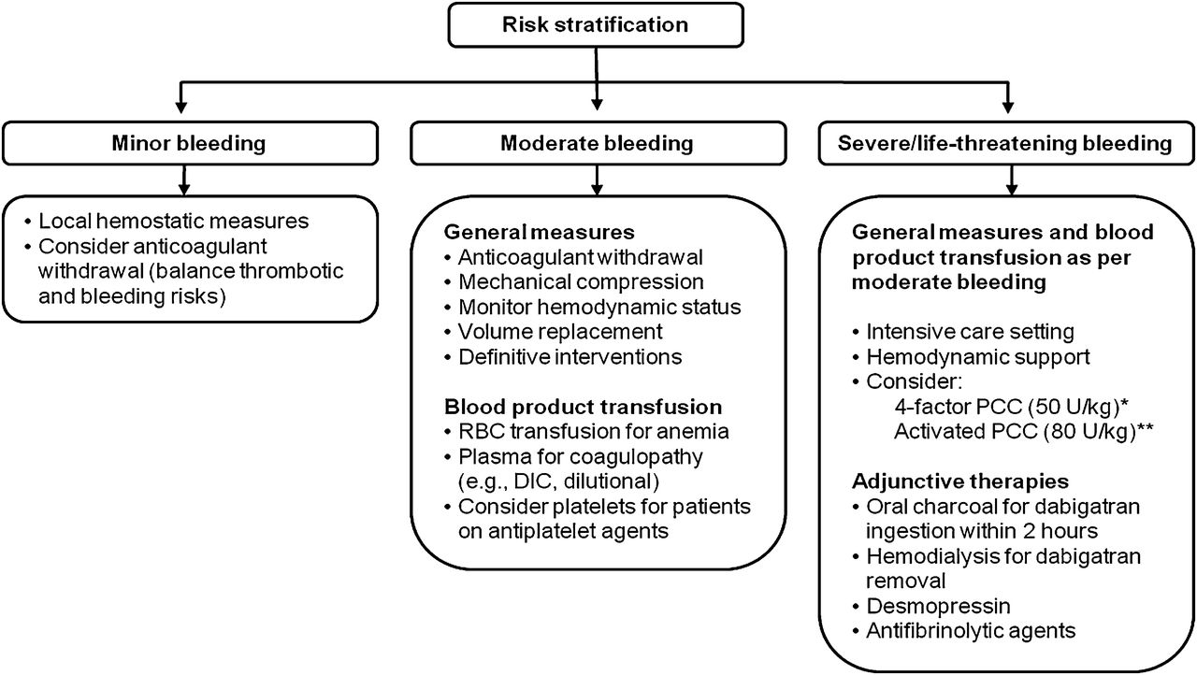

Suggested strategy for management of TSOAC-associated bleeding.
Siegal D M et al. Blood 2014;123:1152-1158
©2014 by American Society of Hematology
Notes:
Suggested strategy for management of TSOAC-associated bleeding. Adapted from previously published review article.³⁴ *Preferred agent for rivaroxaban/apixaban. Possibility of benefit must be balanced against known risk of thrombosis. **Preferred agent for dabigatran. Possibility of benefit must be balanced against known risk of thrombosis. DIC, disseminated intravascular coagulation; RBC, red blood cell.
Minor Bleeding (epistaxis, ecchymosis, menorrhagia) Moderate bleeding (GI bleed)
Major bleeding : use non-specific reversal strategies. aPCC is weakly prefered for Dabigatran, however use of either PCC or aPCC is based on low quality data and neither should be considered a requirement in severe bleeding.

Slide 44
Notes:
Repeat PT/INR, aPTT, anti-Xa and TT 30 minutes after FEIBA

Slide 45
* For patients on Dabigatran, hemodialysis can be considered

Slide 46
Specific Antidotes on the Horizon
Specific antidotes may provide an additional option for bleed management
Idarucizumab (Dabigatran)
Andexanet alpha (Fxa inhibitors)
Clinical use expected in 2016

Slide 47
Conclusion
The filed of thrombosis and anticoagulation is rapidly evolving
Patients taking anticoagulants frequently require surgery
Perioperative management of patients treated with NOACs is an ongoing challenge
Despite lack of antidote, outcomes of major bleeding are similar or better compared with warfarin
Until specific antidotes are available, bleed management protocols may improve outcomes

